Slide 1

Next.js
The React Framework for the Web

Slide 2
Birth
Not too long ago, in 2015, React.js entered the scene. However, even the journey of JavaScript in the IT industry hasn't been exceptionally long. Originally developed by Brenden Eich at Netscape in 1995, JavaScript gained significant popularity during the 2000s.
This was largely due to Google's ingenious utilization of JavaScript to introduce interactive and dynamic features for map exploration. Subsequently, developers were introduced to frameworks and libraries, including jQuery, Angular, Node.js, React.js, and, most recently, Next.js. These technologies have revolutionized the web development landscape, offering developers various capabilities and possibilities.

Slide 3
Birth
You might wonder why this information is relevant in the context. The significance lies in the fact that it highlights the timeless truth that "change is constant." As we continue to advance and evolve as a society, our tools and technologies will naturally progress alongside us. These technologies and tools share a common purpose: to enhance work efficiency and improve performance. In this era, we can still use vanilla JavaScript or create websites using HTML and CSS without a doubt

Slide 4
Birth
However, when it comes to developing applications on a large scale, the efficiency of using the latest technologies surpasses that of traditional approaches. Here is a well-known code snippet implemented in various frameworks, starting from the core JavaScript language itself — The Hello World:

Slide 5
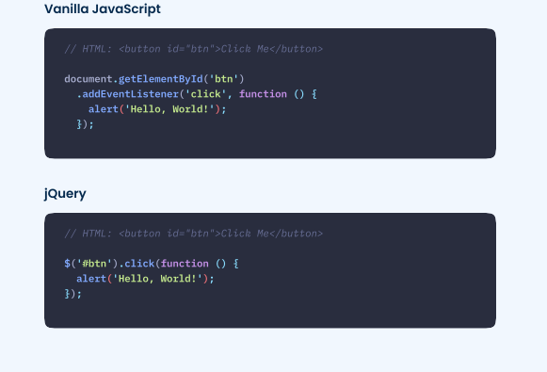

Slide 6
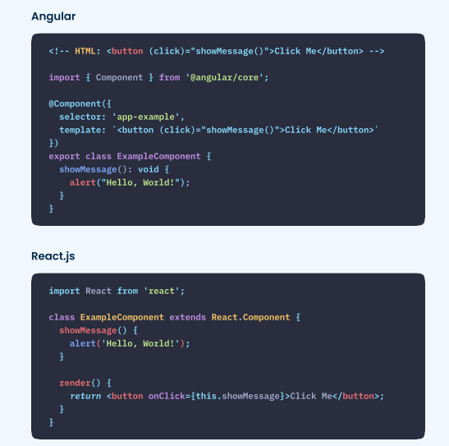

Slide 7
Birth
However, it's important to consider the bigger picture. And that's what truly matters, doesn't it? In reality, we don't just build "Hello World" projects. We undertake more substantial projects that demand the utilization of various frameworks and tools to achieve the desired functionality and scalability.
It is worth mentioning a few foundational reasons why these new tools make development more efficient:

Slide 8
Architecture — React and Angular follow a Component-Based Architecture, encouraging code reusability. For instance, if you create a component like a Button, you can use it anywhere in the application as often as needed. This reusability enhances the maintainability and scalability of the application.
Virtual DOM — The Virtual DOM is a lightweight representation of the actual DOM. It facilitates efficient and optimized updates to the user interface, resulting in improved performance. Simply put, it tracks changes within the application and performs a "diffing" process by comparing the previous version of the virtual DOM with the new version. It identifies the differences and updates the real DOM accordingly.
Ecosystem & Community — Modern libraries like React.js have vibrant and active communities. This provides developers with abundant resources, extensive documentation, reusable code packages, bug fixes, and support.

Slide 9
But hey, where does Next.js come in the picture?
As mentioned earlier, as we continue to progress, technology also advances. jQuery addressed the limitations of vanilla JavaScript, and then React.js emerged to overcome the shortcomings and loopholes of jQuery. However, even React.js has its own challenges, which have now been addressed by another tool called Next.js. It’s a big misconception that Next.js is a new language or library. No!
Vercel, the team behind Next.js, embarked on a unique approach to develop a framework encompassing client-side (frontend) and serverside (backend) functionalities within a single application.

Slide 10
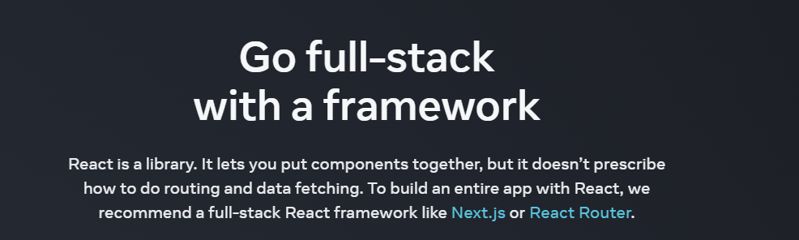
The creators of React.js. Meta now explicitly recommends that developers use Next.js as their primary tool instead of relying solely on React.js.
react.dev

Slide 11
Introduction
Next.js — A flexible React Framework. But what does that mean? In software development, a framework serves as a tool equipped with predefined rules and conventions that offer a structured approach to constructing an application. It provides an environment that outlines the overall architecture, design patterns, and workflows, allowing developers to focus on implementing specific application logic rather than dealing with low-level design.
Simply put, a framework provides pre-built solutions for common functionalities such as integrating databases, managing routing, handling authentication, and more.

Slide 12
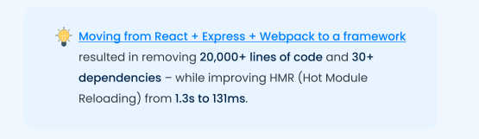
Introduction
In fact, the Vice President of Vercel, Lee Robinson, expressed the following viewpoint:

Slide 13
Introduction
Hmm, alright. I'm willing to trust your insights on the new features of Next.js and such. However, is it actually being used by people? Are companies actively seeking professionals with Next.js expertise? Is there a high demand for it in the industry? — Are you wondering the same? Let the data speak for itself:

Slide 14
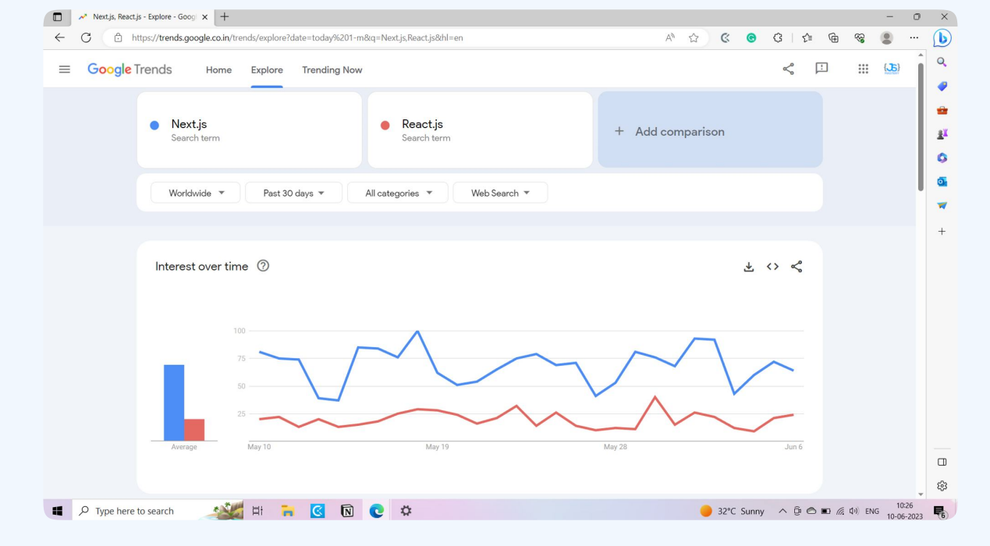

Slide 15
Introduction
In the past 30 days, Next.js has received significantly higher search interest worldwide than React.js. But hey, that’s just a Google trend. What about the industry? Are people even creating websites using Next.js?
Sure, let’s take a look at “The Next.js Showcase” which shows different companies using Next.js:
Head over nextjs.org/showcase

Slide 16
Roadmap
Before we start exploring Next.js, reviewing or relearning some basic concepts is a good idea to make learning easier. It all begins with building a solid foundation through fundamentals. Think of this roadmap as a summary of what you should know as a foundation for learning Next.js. It's alright if you're unfamiliar with advanced topics like integrating databases or implementing authentication.
These points help you understand the main concepts without focusing on specific coding details.

Slide 17
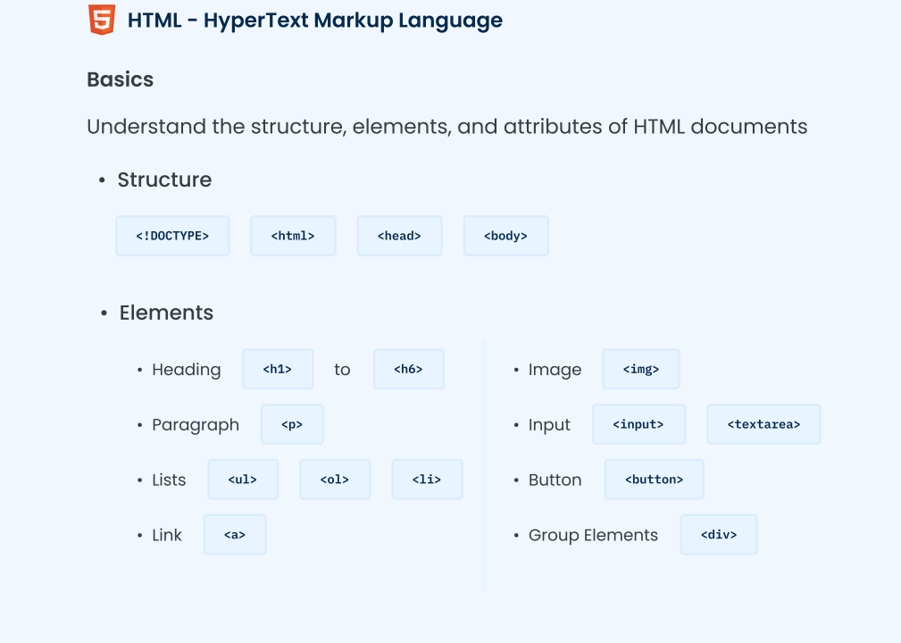
1- Web Development Fundamentals

Slide 18
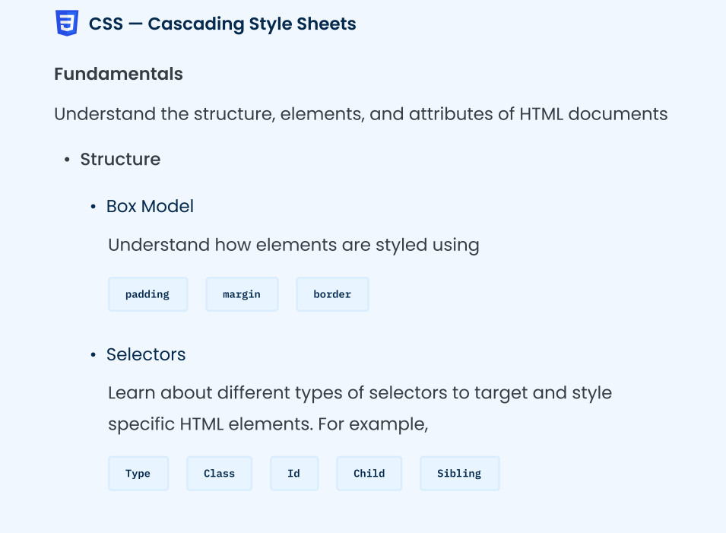
1- Web Development Fundamentals

Slide 19
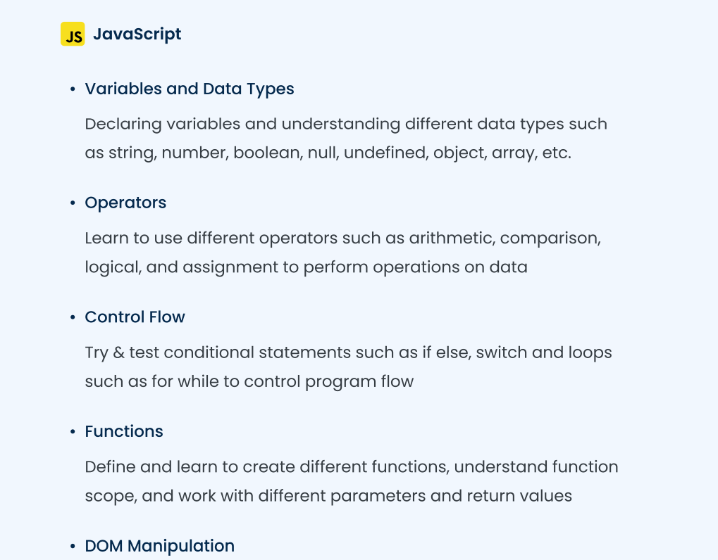
1- Web Development Fundamentals

Slide 20
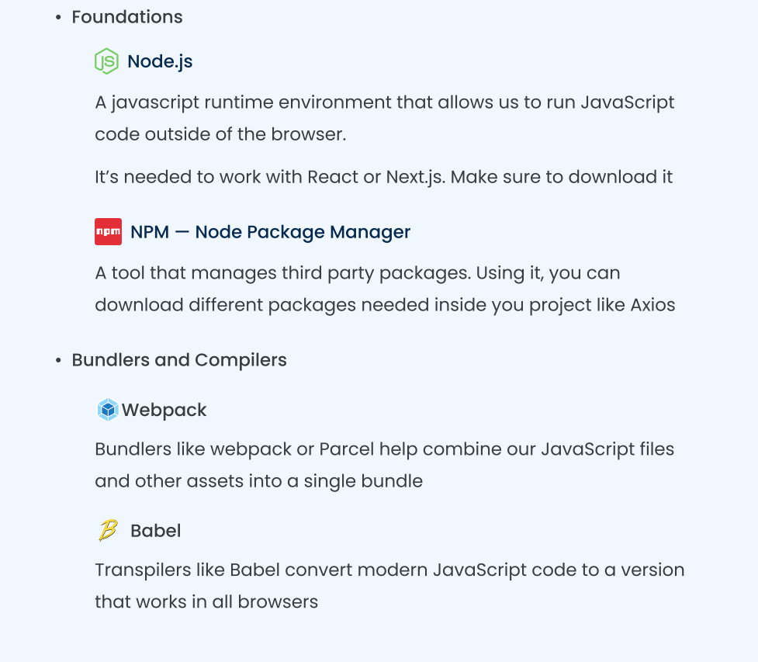
2- The Ecosystem

Slide 21
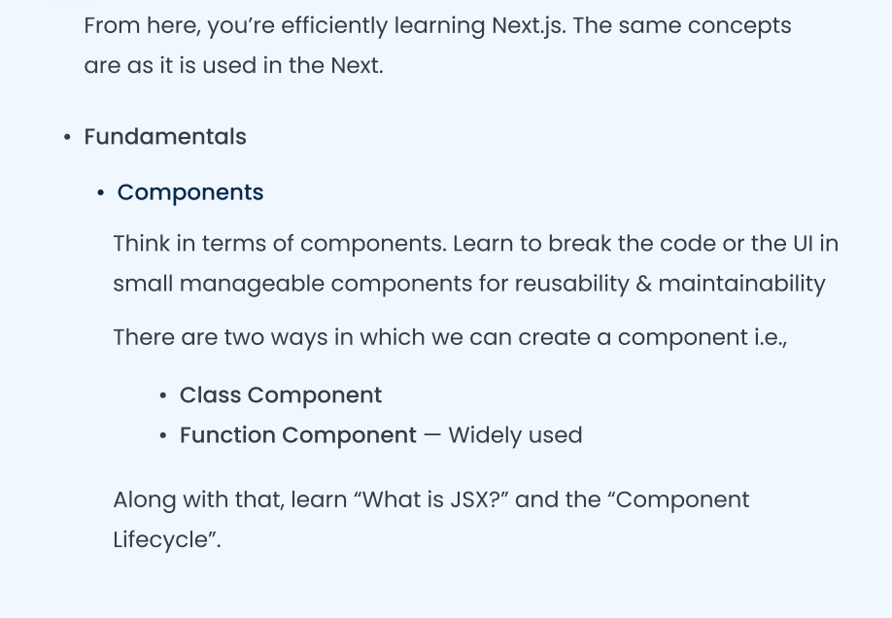
3- React JS

Slide 22
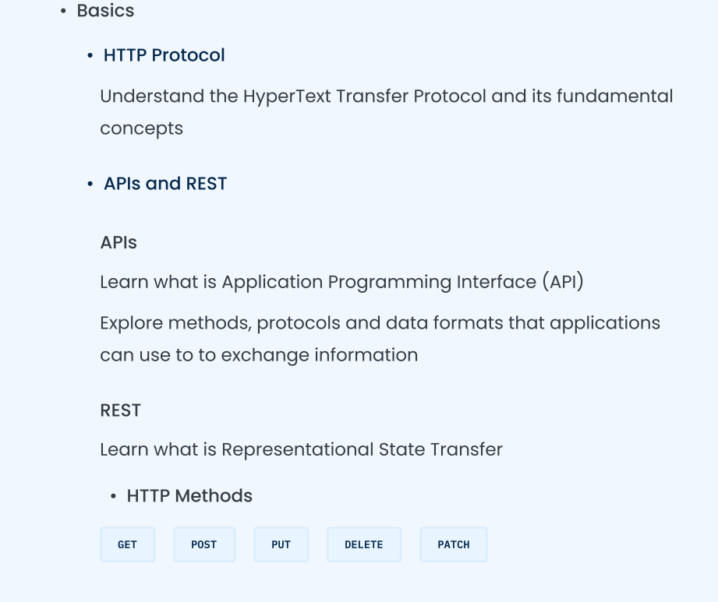
4- Backend

Slide 23
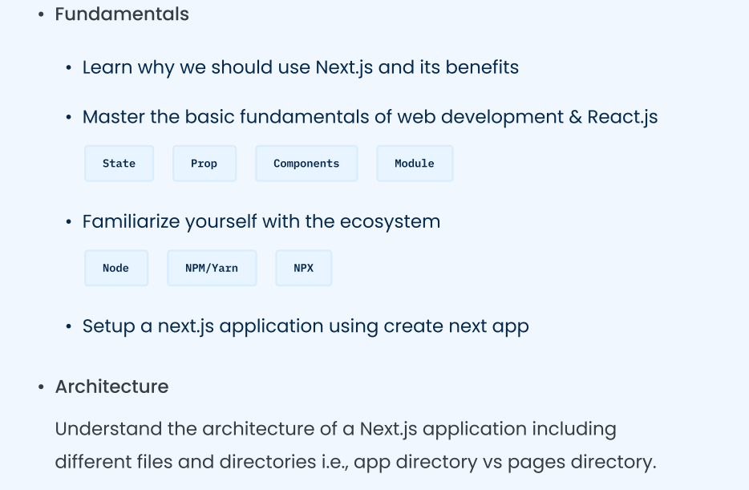
5- The Next.js

Slide 24
How it works
Let’s time-travel a bit to see how things were used to work with different technologies.

Slide 25
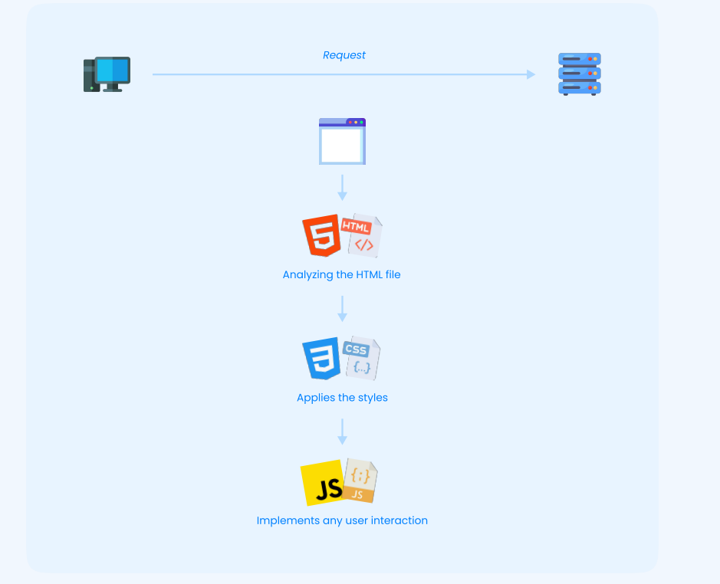
The vanilla — HTML, CSS, and JavaScript

Slide 26
How it works
Traditionally, for each of these requests, the server responds by sending three files i.e., the HTML, CSS, and JavaScript (only if any JavaScript code is involved). The client's browser receives these files and begins by analyzing the HTML file. Then, it applies the styles from the CSS file and implements any user interaction, such as event handlers or dynamic behavior, specified in the JavaScript file on the webpage. The client will send additional requests to the server if the website has multiple pages. In response, the server will send the three files containing the respective content needed to render each page.

Slide 27
The React way
This is where React comes in. It improved the development lifecycle by introducing components, virtual DOM concepts, and the client-server mechanism. When you access a React website, the client's browser sends a request to the server for the webpage content. In response, the server sends a minimal HTML file, which serves as the entry point for the entire application, along with a bundled JavaScript file.
React initiates client-side rendering using this JavaScript file, manipulating the virtual DOM. Instead of directly modifying the actual DOM, React updates the virtual.

Slide 28
The React way
React utilizes its client-side routing library, React Router, to navigate to different pages within the React application. This library enables changing the route without a full server request, preventing page refreshes. React Router re-renders the relevant components based on the new URL when a new route is triggered. If the new page requires fetching data from the server, the corresponding components initiate requests to retrieve the necessary data.

Slide 29
What’s the catch?
Complexity Building a React application can present greater complexity than traditional HTML, CSS, and JavaScript websites. It involves thinking in components, managing state and props, and working with the virtual DOM, which may require a learning curve for developers new to React.js.
Processing Similar to the traditional approach, react primarily performs client-side rendering. It heavily relies on JavaScript for initial rendering and subsequent requests to update the user interface, which are all handled on the client’s browser. However, this reliance on client-side rendering can delay rendering and interactivity, particularly on devices with slower processors and limited resources.
SEO Yes, if you recall, we previously touched upon a notable drawback of React compared to Next.js in the Introduction chapter. The issue is that search engine crawlers might need help fully accessing the website's content since everything is handled through JavaScript and only rendered on the client side. As a result, it impacts the website’s visibility in search engine results

Slide 30
The Next.js Way - A blend of both
Knowing the benefits and limitations of both techniques, Vercel developers allowed us to choose where to render the content, on the client or server. Typically, when a user visits a Next.js site, the client sends the request to the server, which starts executing the React Components, generates HTML, CSS, and JavaScript files, and sends back the fully rendered HTML to the client as a response. This file includes initial content, fetched data, and React component markup, making the client render it immediately without waiting for JavaScript to download and execute.

Slide 31
The Next.js Way - A blend of both
But it doesn’t mean we don’t receive any JavaScript files. The server will still send the JavaScript code as needed for the user interaction. From here, Next.js takes over and performs client-side hydration Have you ever encountered the issue of a hydration error where the user interface doesn't match what was originally rendered on the server? Well, this is what it is about. Hydration is attaching JavaScript event handlers and interactivity to the pre-rendered HTML. And when the placeholders of React components don’t match what’s being rendered on the client side, you see that error.
This is what it is — The hot topic of web development ,SSR Server Side Rendering!

Slide 32
Create a Next.js Application
Coding Time!

Slide 33

TechTalks Community

